Slide 1

SuStainableuse
The way you think determines
Your behaviour
Notes:
Hello, today, we will be introducing to you our innovative solution for combatting the challenges of present-day consumer electricity consumption.

Slide 2
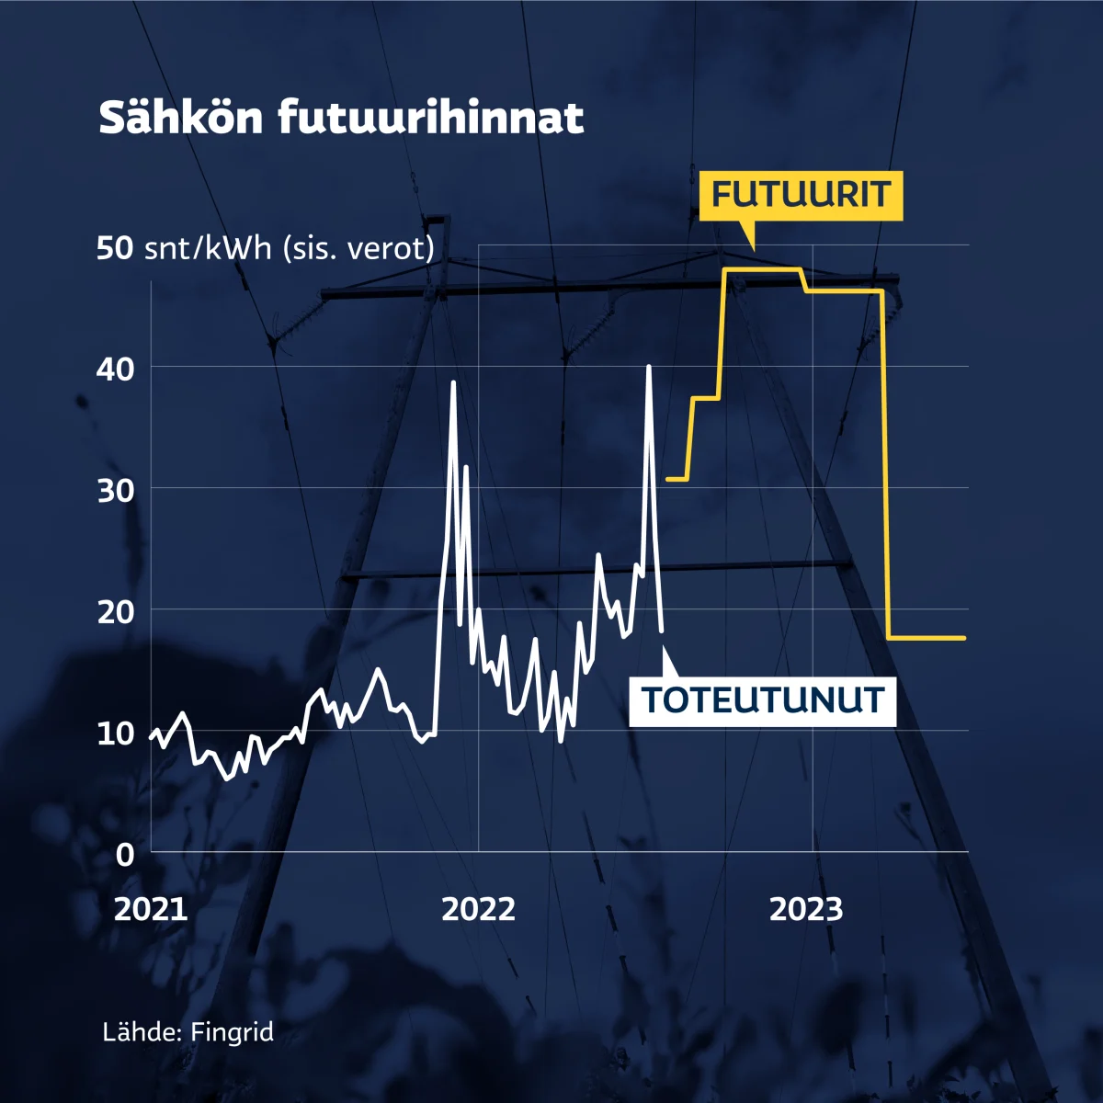
RECAP
Energy efficiency in electricity usage
Usage tracking
Predicting future consumption amounts

Slide 3
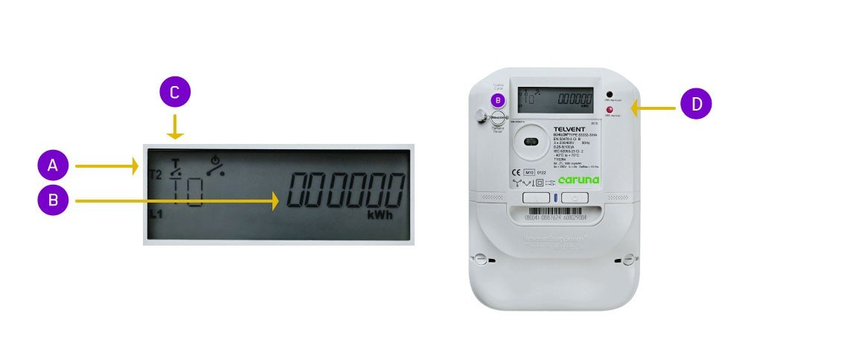
Electricity meter
Measures passing electric current
Remotely readable digital meter
Data sent to hubs
Forwarded using a mobile network
Unit of measurement: kWh
Source: Caruna Oy

Slide 4
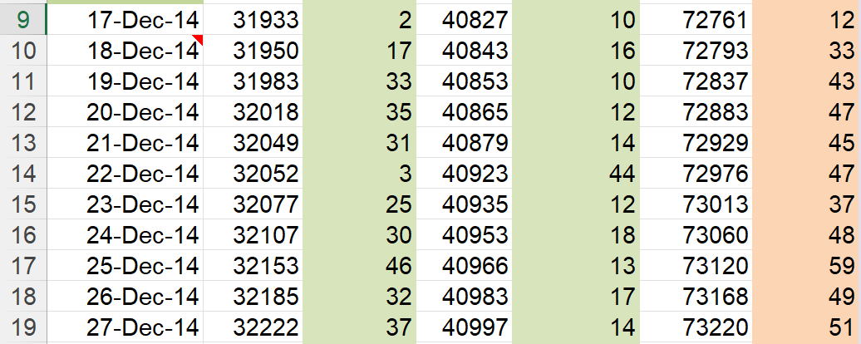
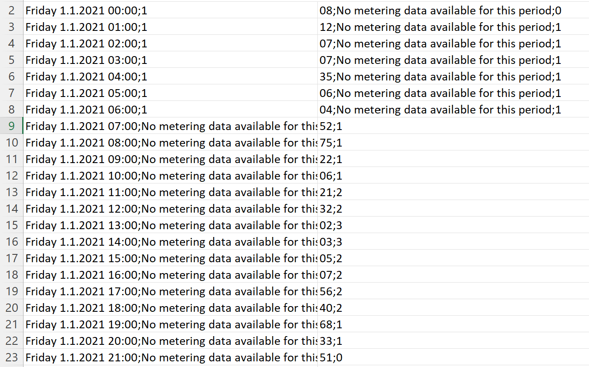
Measurements taken: 1.1.2021 - 3.11.2022
Hourly consumption readings
Used for visualizations of past consumption
DATASETS
Measurements taken: 12.12.2014 - 5.11.2022
Daily consumption readings
Used for prediction of future electricity consumption

Slide 5
Consumption Prediction
Data
Collection
Data Cleaning
Construction
of Fourier
model
Prediction
Obtain data by recording and collecting the daily power consumption
Data repair by processing missing data and eliminating crippled data
Dealing with duplicate data
Handle erroneous and unusable data to organize data format
Construct Fourier fit models from the data
Adjust fitting parameters to improve accuracy of the model
Predicting the future daily electricity consumption of the customer to allow easy comparison to current usage

Slide 6
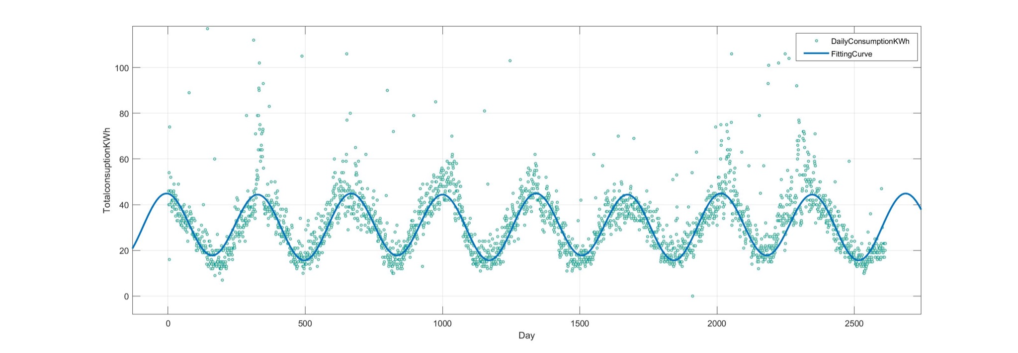
Fourier fit models
1. Data Content
Data includes daily electricity consumption of the household from 2015-2022
2. Goodness of fit:
SSE: 1.146e+04
R-square: 0.9869
Adjusted R-square: 0.9869
RMSE: 2.098
3. General model Fourier 2:
Coefficients (with 95% confidence bounds):
a0 = 30.69 (30.61, 30.77)
a1 = -0.04447 (-0.1613, 0.07237)
b1 = 1.1 (0.9875, 1.213)
a2 = 11.88 (11.76, 11.99)
b2 = 7.343 (7.23, 7.456)
w = 7.033 (7.029, 7.037)
Function:
f(x) = a0 + a1*cos(x*w) + b1*sin(x*w) + a2*cos(2*x*w) + b2*sin(2*x*w)
where x is normalized by mean 1309 and std 753.5

Slide 7
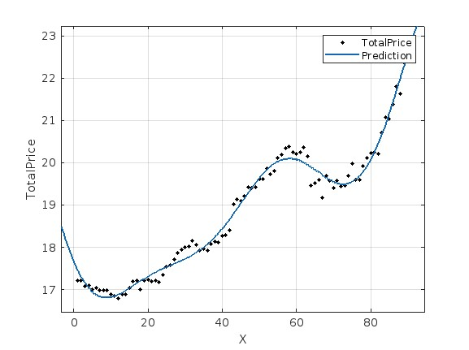
Fourier fit models
1. Data Content
Data includes electricity price in Finland from 2020-2022
2. Goodness of fit:
SSE: 3.052
R-square: 0.9843
Adjusted R-square: 0.9883
RMSE: 0.1929
3. General model Fourier 2:
Coefficients (with 95% confidence bounds):
a0 = 19.81 (19.36, 20.26)
a1 = -1.743 (-2.519, -0.968)
b1 = 2.038 (1.859, 2.216)
a2 = 1.471 (1.053, 1.889)
b2 = -0.7512 (-0.9088, -0.5935)
a3 = -0.4238 (-0.5533, -0.2943)
b3 = 0.6684 (0.5849, 0.7518)
w = 1.297 (1.213, 1.382)
Function:
f(x) = a0 + a1*cos(x*w) + b1*sin(x*w) +
a2*cos(2*x*w) + b2*sin(2*x*w) + a3*cos(3*x*w) + b3*sin(3*x*w)
where x is normalized by mean 45.5 and std 26.12

Slide 8
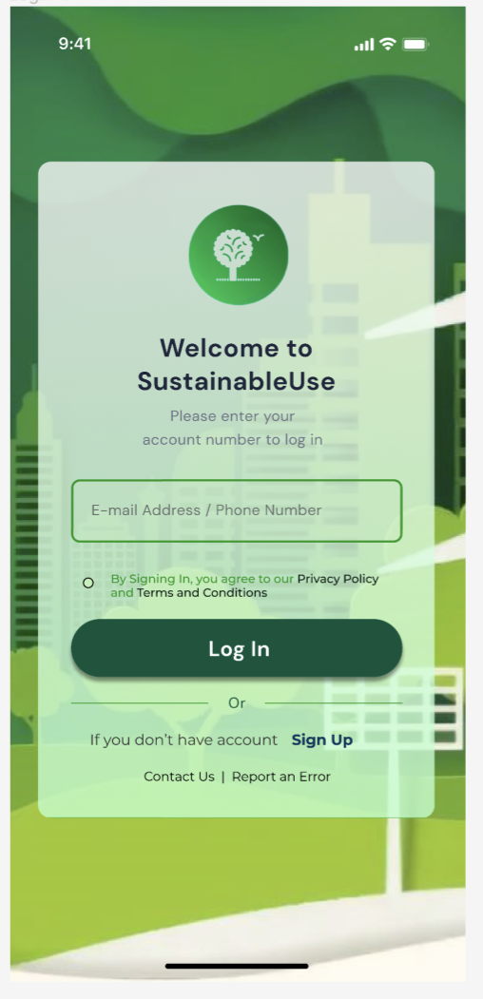
Application
Notes:
Visualizing the data allows the users to see how much electricity is consumed at any given time. With the features such as Oasis, the application aims to raise awareness about energy conservation and enable users to be proactive and take adequate measures to save energy and reduce their carbon dioxide emissions ultimately. For example, they can calculate their carbon savings to gain energy which they can use that to grow a tree in the real world.

Slide 9
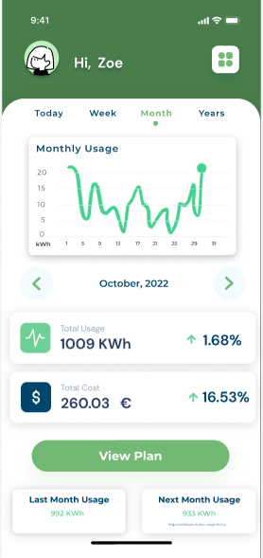
Data Visualization
Visualizing data allows users to see their electricity consumption habits easily
With the function like create user’s own electricity consumption plan, the application aims to raise awareness about energy conservation
The demo: https://youtu.be/Q_L9JdgW4bA

Slide 10
VALUE AND CONCLUSION
CURRENT
CONSUMPTION
Any Time
FORECAST
CONSUMPTION
Model Combined
95% accuracy
CUSToMIZEd
PLANs
Compare with
Actual
VIEW & FEEL
Deeply and Directly
Enhance awareness
Energy Conservation
Save expenses
Energy Saving
AJUST USE
According Needs

Slide 11
Thank YOU FOR LISTENING!

